Slide 1
WORKFLOW AUTOMATION
WE REDIFINE SOLUTIONS.

Slide 2
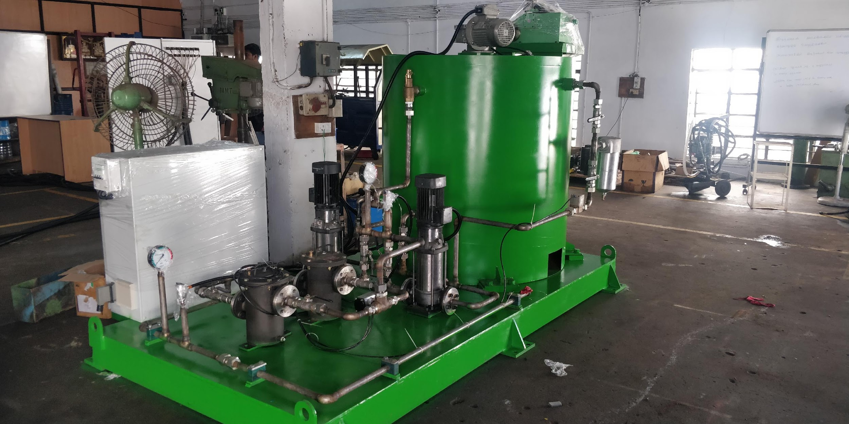
GRAPHITE LUBRICATION SYSTEM
A STEP TOWARDS GREENER ENVIRONMENT

Slide 3
BRIEF DESCRIPTION
Graphite lubrication is a liquid based system used in the forging industry. The closed circuit graphite lubrication system reduces friction and forging loads, and improves die life.
WFA's lubrication system has a collection tank which is placed beneath the forging press where all the sprayed graphite lubricants are collected and transferred to the supply tank.
The system has proved to be a safe and eco-friendly alternative of dry graphite spray lubrication technique.

Slide 4
GRAPHITE LUBRICATION PROCESS
Dry graphite spraying method is replaced with liquid graphite for lubrication in forging.
Graphite lubricant is flooded on the forging die.
Used graphite liquid is collected through a hopper in SS Collecting tank.
To restrict the bonding of graphite inside the tank, a stirrer is used to keep the mixture uniform and un coagulated.
To remove any foreign material mixed in liquid after forging, The liquid is passed through the magnetic separator before entering the SS Supply tank.
The liquid is filtered by primary and secondary filter, before it is flooded on the die.

Slide 5
WHY WE NEED GRAPHITE LUBRICATION SYSTEM?
Safe workplace
Direct Human exposure to graphite molecules is eliminated.
No graphite deposits results in safe and non-slippery environment.
Leaner process
Lubrication can be simultaneously incorporated with main forging process.
Cycle time is reduced significantly.
Cost Reduction
Graphite infused in the liquid can be reused for multiple cycles, thus drastically reduces consumption of new graphite material.

Slide 6
HOW GRAPHITE LUBRICATION SYSTEM CHANGED FORGING INDUSTRIES
Automatic lubrication reduces production time and increases capacity of the industry.
Since the lubrication is installed along with the press the time required for lubrication can be completely eradicated.
Unlike the graphite spraying method there was no black graphite deposits found on the work floor.

Slide 7
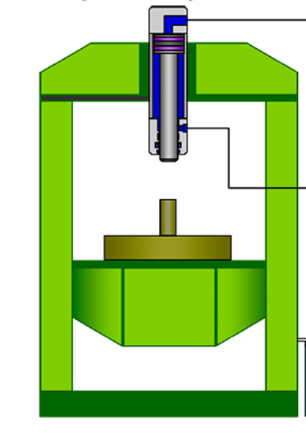
SCHEMATIC REPRESENTATION
SS Supply Tank
Press Control Unit
Nozzle
Primary and secondary Filter
Forging Press
Stirrer
Ground level
Pump
Hopper
SS Collection Tank
Magnetic Separator
Pump

Slide 8
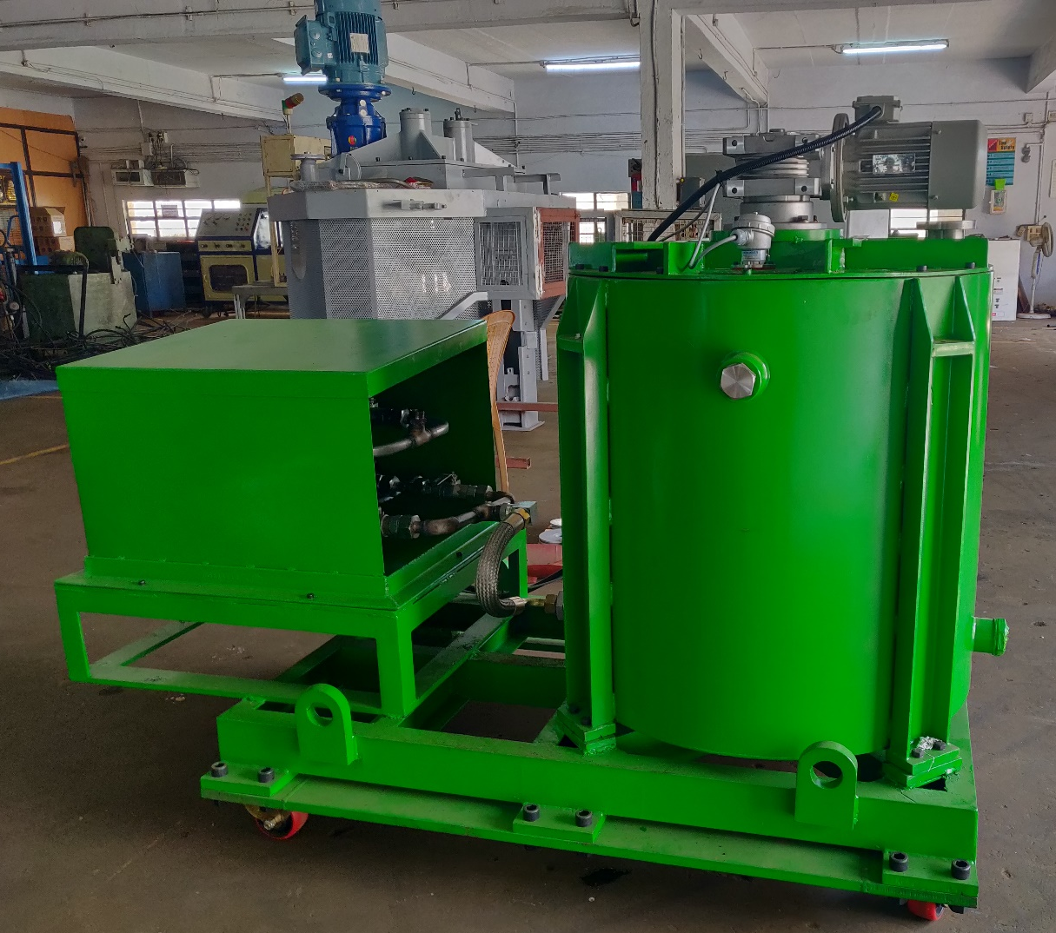
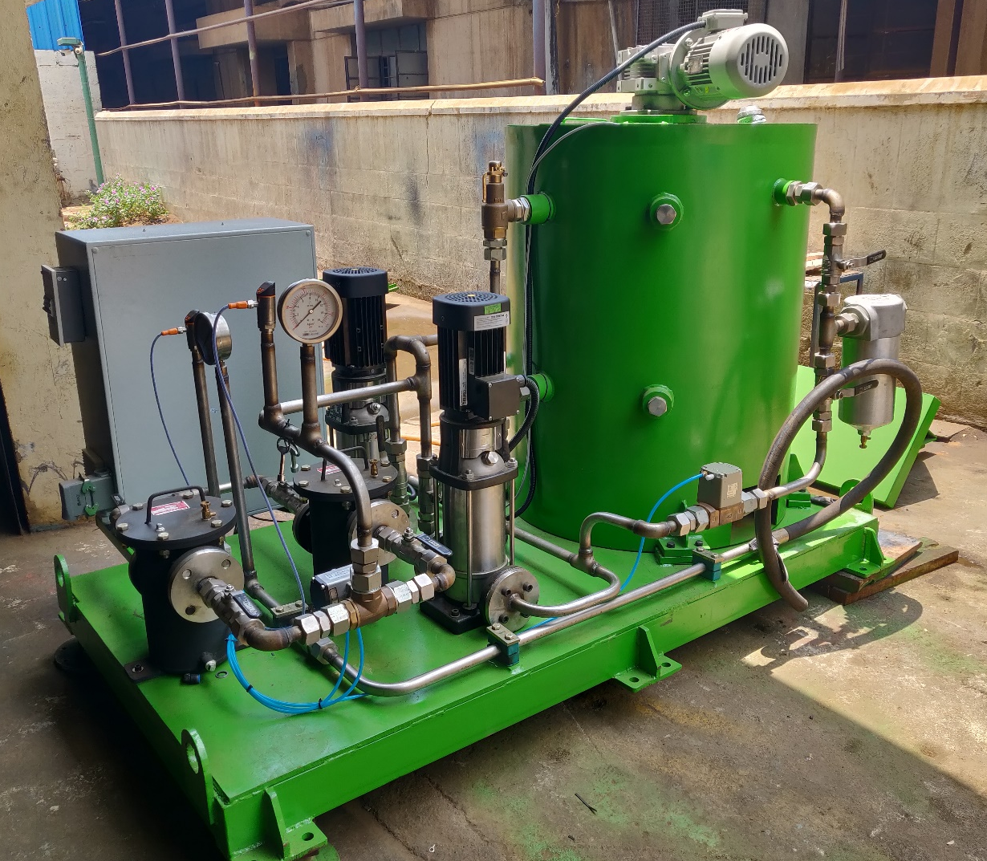
COMPLETELY ASSEMBLED MACHINE

Slide 9
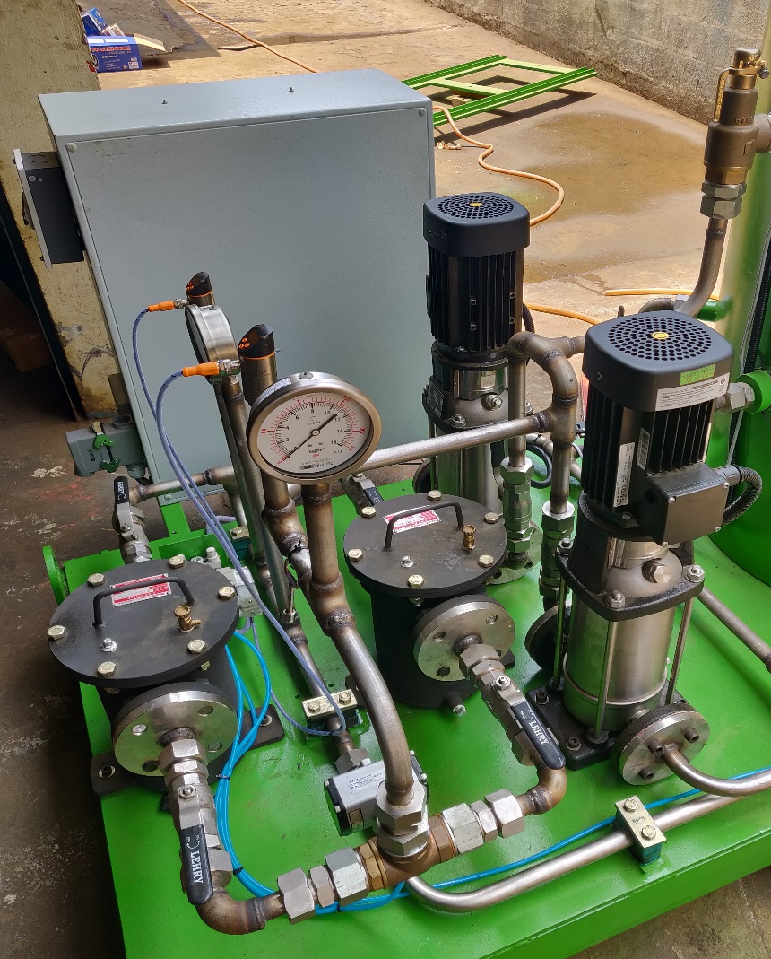
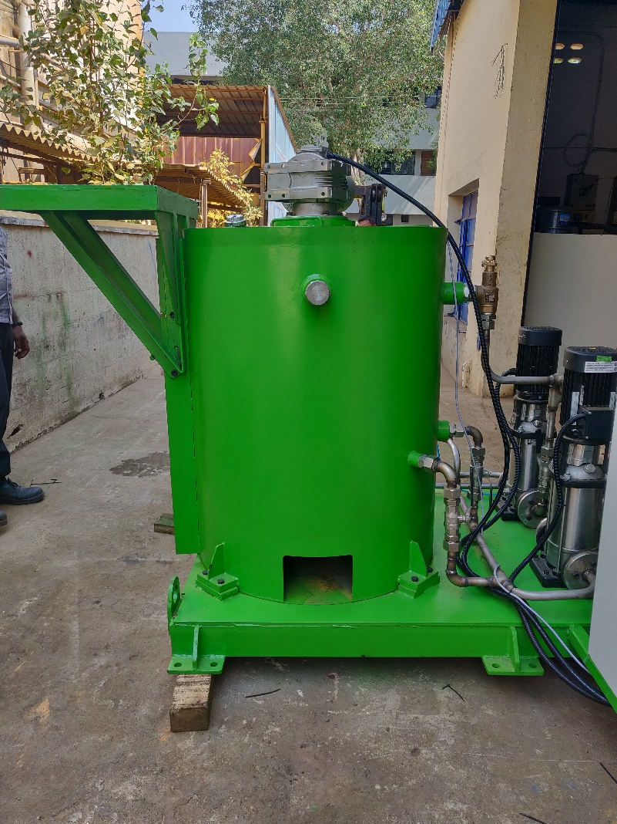
PARTS OF SUPPLY TANK

Slide 10
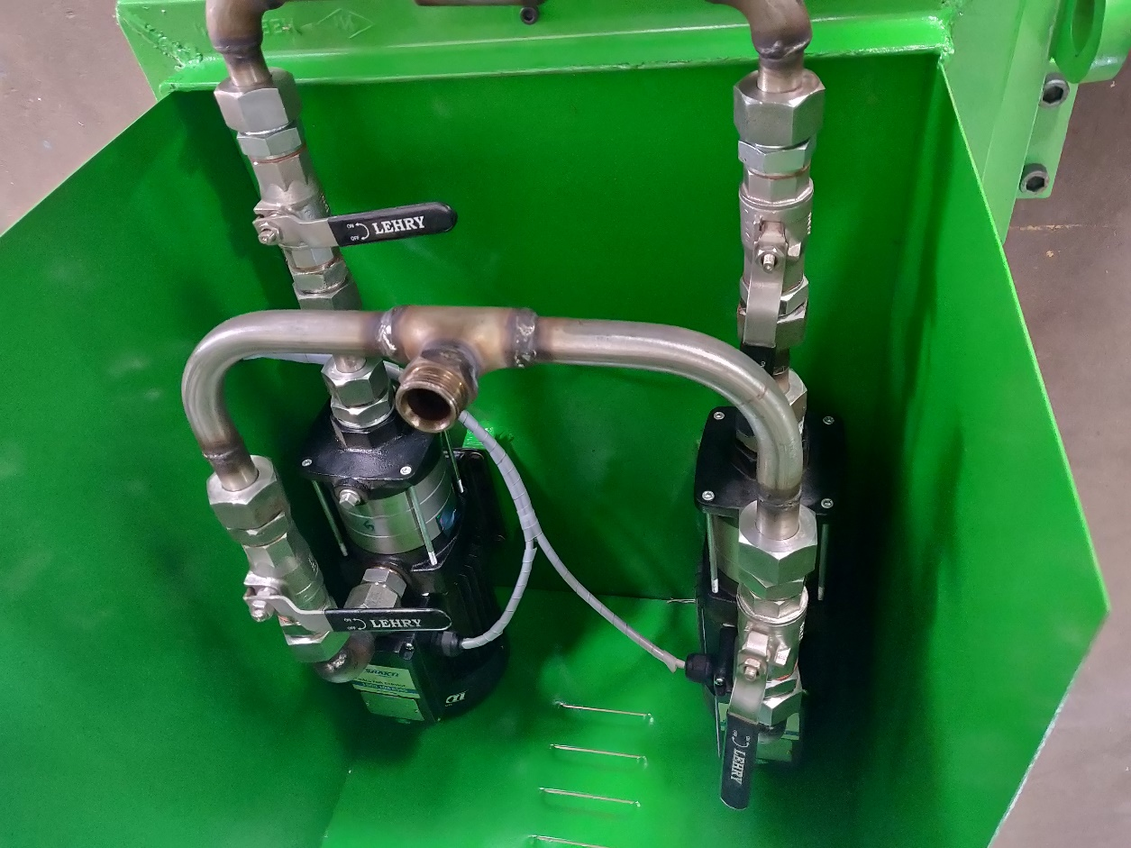
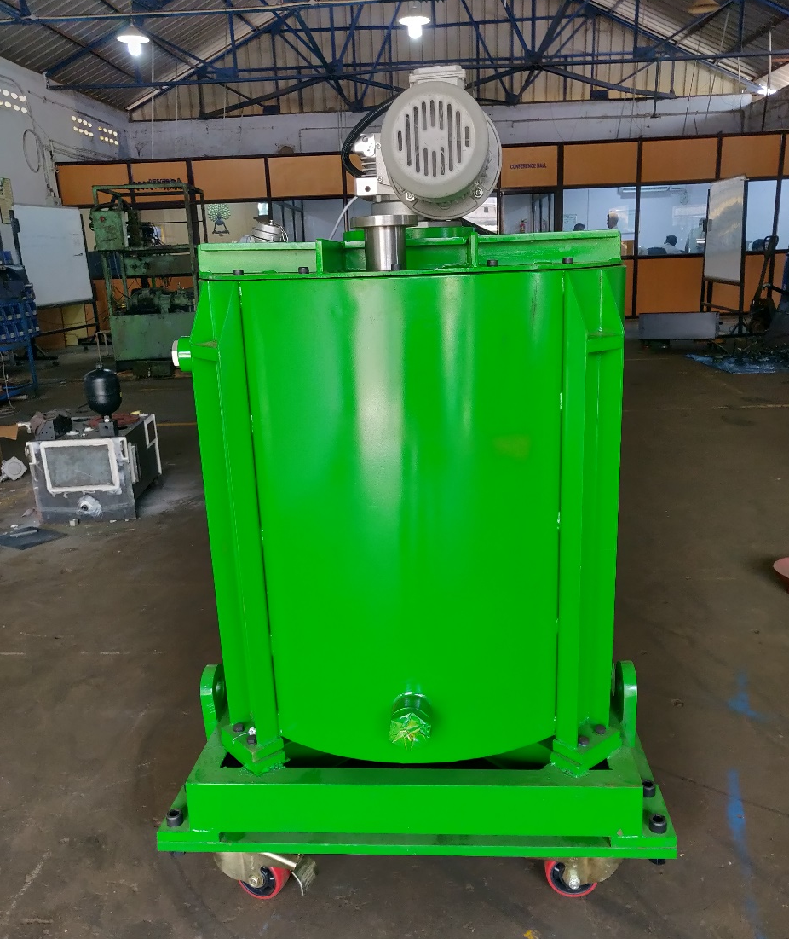
PARTS OF COLLECTION TANK

Slide 11
THANK YOU!
+91 9381053100 / +91 9940012107
office@workflowautomation.in
www.workflowautomation.in

